Slide 1
Introduction to the Unified Patent Court
Stefan Luginbuehl
Lawyer, International Legal Affairs, PCT
European Patent Office Munich
09.04.2015

Slide 2
The European Patent Convention (EPC)
Centralised procedure for the grant of patents on the basis of uniform European patent law and conducted in a single language
European patent has the effects of a national patent and is interpreted on the basis of the applicable national and European provisions (Art. 2(2) EPC)

Slide 3
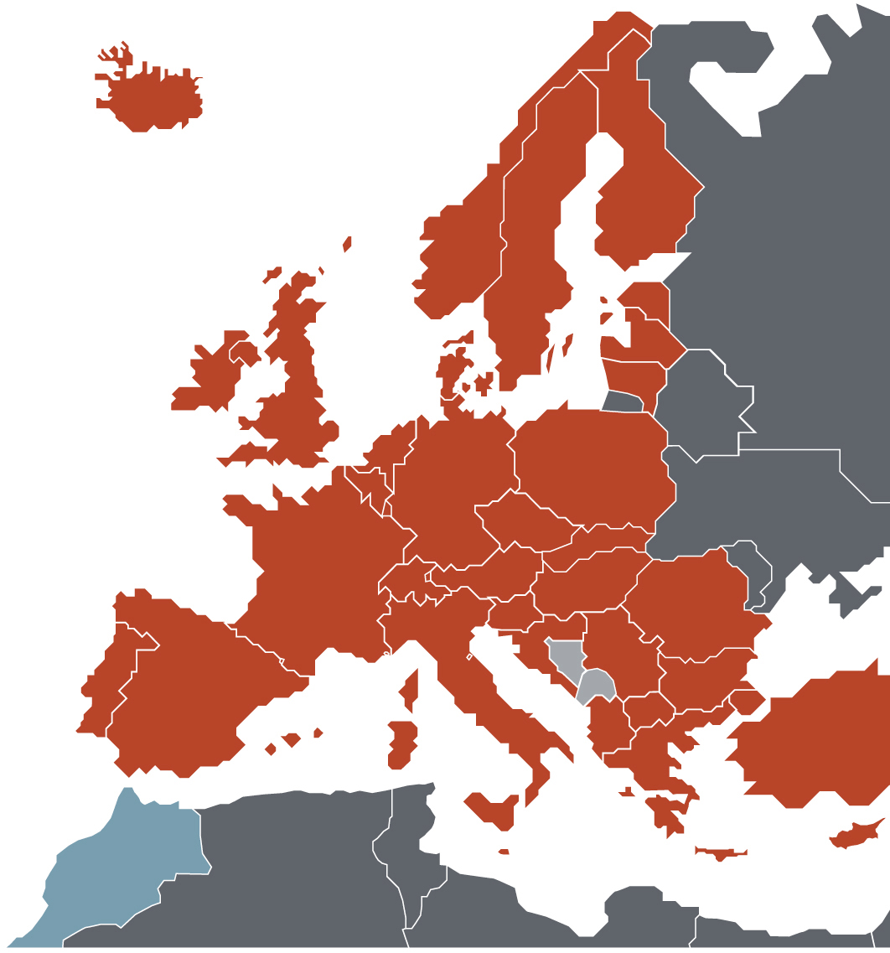
European Patent Organisation
38 European member states
Belgium • Germany • France • Luxembourg
Netherlands • Switzerland • United Kingdom Sweden • Italy • Austria • Liechtenstein Greece • Spain • Denmark • Monaco
Portugal • Ireland • Finland • Cyprus
Turkey • Bulgaria Czech Republic
Estonia • Slovakia • Slovenia • Hungary
Romania • Poland • Iceland • Lithuania
Latvia • Malta • Croatia • Norway
Former Yugoslav Rep. • Macedonia
San Marino • Albania • Serbia
2 European extension states Bosnia-Herzegovina • Montenegro
1 Validation state
Morocco

Slide 4
Problems related to patent litigation in Europe
Sub-optimal enforcement scheme implying legal uncertainty:
No common European patent litigation system
Application and interpretation of EPC not fully harmonised
Jurisdiction of too many courts/authorities
Unbalanced qualification & experience of judges
Multiple litigation
High costs, delays and risk of diverging decisions
Differences of civil procedure

Slide 5
From European Patent Litigation Agreement to the Agreement on a Unified Patent Court
1999/2000: Intergovernmental Conferences of EPC contracting states
2003: Draft European Patent Litigation Agreement (EPLA) and draft Statute of the European Patent Court
2008: Draft Agreement on the European Union Patent Court
2013: Agreement on a Unified Patent Court (UPC Agreement)

Slide 6
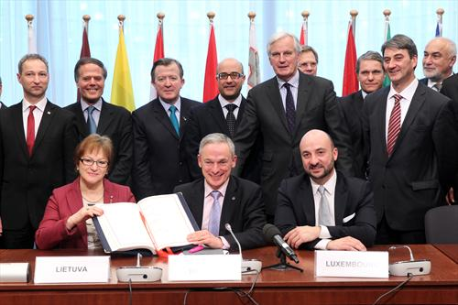
The UPC Agreement
The UPC Agreement was signed on 19 February 2013 by 25 EU member states (not by Croatia, Poland and Spain) (OJ EPO 2013, 287-364)
It will enter into force after the deposit of the 13th instrument of ratification or accession, including FR, DE and UK So far, six states have deposited their instruments of ratification AT: 7 August 2013, FR: 14 March 2014, SE: 5 June 2014, BE: 6 June 2014, DK: 20 June 2014, MT: 9 December 2014 Several states have already indicated their intention to ratify in 2015

Slide 7
UPC Agreement : Court structure
Court of Justice of the EU
Requests for preliminary rulings
Court of appeal
Luxembourg
Central division
Paris (general)
London (pharmaceuticals)
Munich (engineering)
Local Divisions
Regional Divisions
Court of First Instance
Notes:
-

Slide 8
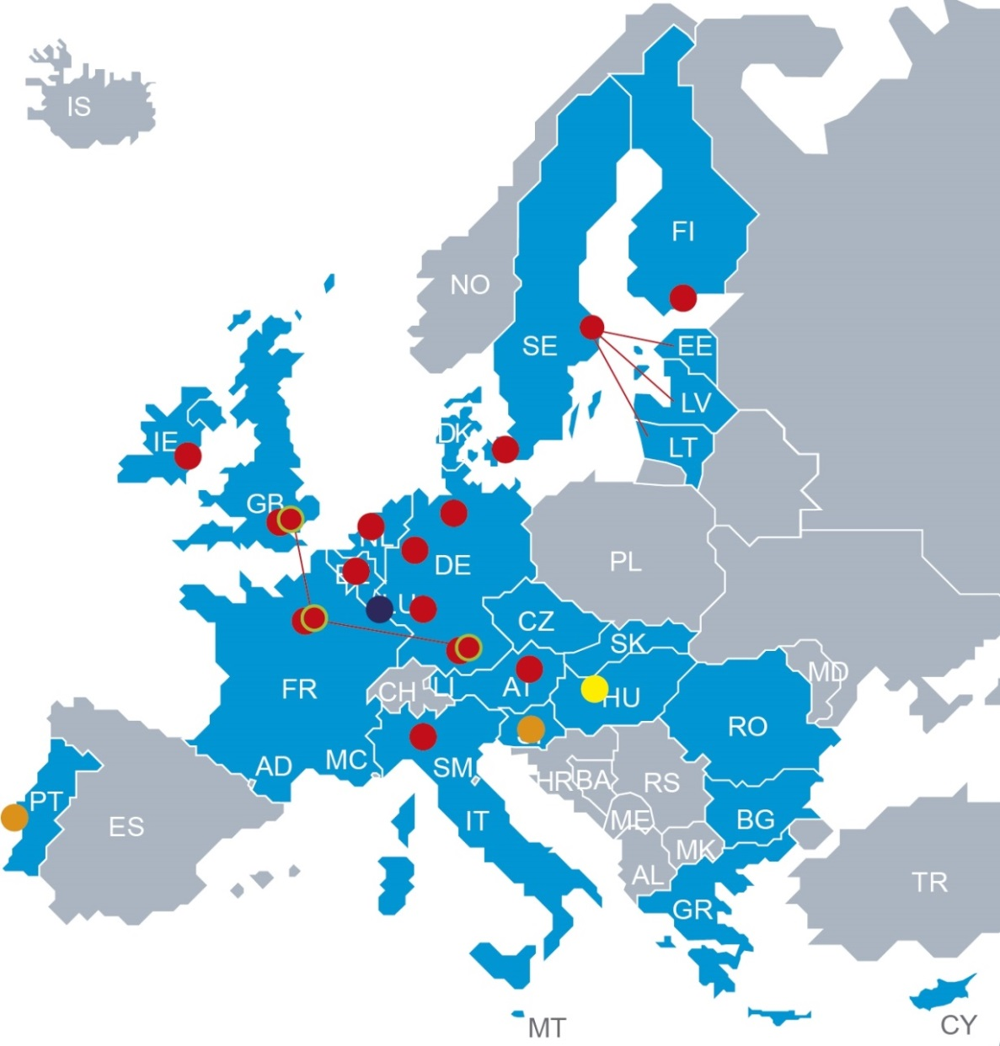
UPC Agreement : UPC locations
Local/regional division(s)
Brussels, Copenhagen, Dublin, Dusseldorf, Hamburg, Helsinki, London, Mannheim, Milan, Munich, Paris, Stockholm, The Hague, Vienna
Patent mediation and arbitration centre Ljubljana, Lisbon

Slide 9
Jurisdiction of the UPC as regards the subject-matter (Art. 32 UPC Agreement)
Exclusive jurisdiction inter alia in respect of actions for
actual or threatened infringement of classic European and unitary patents and Supplementary Protection Certificates (SPCs) and related defences, including counterclaims concerning licences,
declarations of non-infringement of classic European and unitary patents,
revocation of classic European and unitary patents
by direct attack
by counter-claim
declaration of invalidity of SPCs
injunctions

Slide 10
Jurisdiction of the UPC as regards the subject-matter (Art. 32 UPC Agreement)
Exclusive jurisdiction inter alia in respect of actions
for provisional and protective measures
for damages or compensation
related to the decisions of the EPO in carrying out the additional tasks concerning the unitary patent

Slide 11
Jurisdiction of national courts (Art. 32(2) and Art. 83 UPC Agreement)
National courts
All actions relating to European patents and unitary patents which do not come within the exclusive jurisdiction of the UPC, such as
actions related to the right to a patent, or
actions related to the transfer of a patent right
Parallel jurisdiction with UPC concerning disputes related to classic European patent during transitional period of at least 7 years
Opt-out possibility

Slide 12
Judges of the UPC (Art. 15 UPC Agreement)
Legally qualified judges & technically qualified judges
must ensure highest standards of competence and have proven experience in the field of patent litigation
Legally qualified judges must possess the qualifications required for appointment to judicial offices in a contracting state
Technically qualified judges must have a university degree and proven experience in a field of technology
Training of judges (Art. 19 UPC Agreement)
Training framework for judges

Slide 13
The Preparatory Committee
Up to date the committee held 9 meetings
Contents of discussions inter alia:
Budgetary rules
Fee structure
Legal aid
Contributions of signatory states
Representation before the UPC
Rules related to the mediation and arbitration proceedings
Training of candidate judges
Rules of proceedings of the UPC different committees
13

Slide 14
Thank you for your attention
Stefan Luginbuehl, PhD Lawyer, International Legal Affairs, PCT European Patent Office, Munich
Tel. +49 89 2399-5290 Fax +49 89 2399-5219 email sluginbuehl@epo.org
www.epo.org

