Slide 1
IPR and competition from the EU perspective — the smartphone patent wars
Adrian Emch
Suzhou 9 May 2015

Slide 2
概述
Basics on SEP abuses
EU cases on SEPs
Orange book case
EU Commission v. Motorola Mobility
EU Commission v. Samsung
Huawei v. ZTE

Slide 3
Basics on SEP abuses
Article 102 TFEU
Injunctive relief for SEP infringement may be abuse of dominance under Article 102 TFEU
In patent infringement case, defendant can raise the "FRAND" defense to argue against injunction
Case law in flux
Infringement cases in national courts (Germany is preferred venue)
European Commission investigations
EU court cases

Slide 4
Orange Book
In Orange Book, German federal supreme court accepted competition law/FRAND defense
Very strict requirements for a defendant to make a successful FRAND defense
Unconditional offer to take a license
For license fee, either (1) offer specific license fee which is at least FRAND or (2) leave license fee to patent holder's fair discretion, but reserve the right to make challenge in court
Pay damages for all past infringement
Comply with the obligations under the proposed licence contract, such as (1) pay royalties into escrow account at local court and (2) render accounts for sales with patent
Notes:
First requirement
I.e., the offer cannot be conditional on
finding of infringement
validity of the patent
essentiality of the patent
This means that, if the patentee accepts the offer, then the defendant is bound to the license and cannot challenge the validity or the infringement any more
Second requirement:
Defendant has two options regarding the offered license fee
First option: the defendant can offer a specific license fee (royalty) which is at least FRAND
Typically, for procedural reasons, there are no or very limited possibilities for the defendant to improve the FRAND offer after the court has stated that the offered fees are not FRAND (this may only be in the judgment)
Therefore, in order to be on the safe side, the defendant actually needs to offer more than FRAND to have a safety margin
Second option: the defendant can leave the license fee to the fair discretion of the patentee, but reserve the right to challenge the patentee's determination of the fee in court
In practice this approach will also result in license fees higher than FRAND
The burden of proof is on the defendant;
i.e., the defendant has to prove that the fees set by the patentee are higher than FRAND which is very difficult
Third requirement:
Defendant has to undertake to pay damages for all past acts of use
in Germany this entails an extraordinary risk as the patent owner can claim extradition of infringer's profits, i.e. very high damages

Slide 5
EC v. Motorola Mobility
Apple filed complaint against Motorola Mobility with EU Commission for seeking injunctions over SEPs
EU Commission held that seeking and enforcing of injunction for SEPs is abusive, unless there is objective justification
Such a justification can be an "unwilling licensee"
Double negative – licensee is not "unwilling" if it does not agree to
right for patent holder to terminate license if validity is challenged
inclusion of products into the license which licensee believes are not infringing
acknowledgement of damage claims for past acts

Slide 6
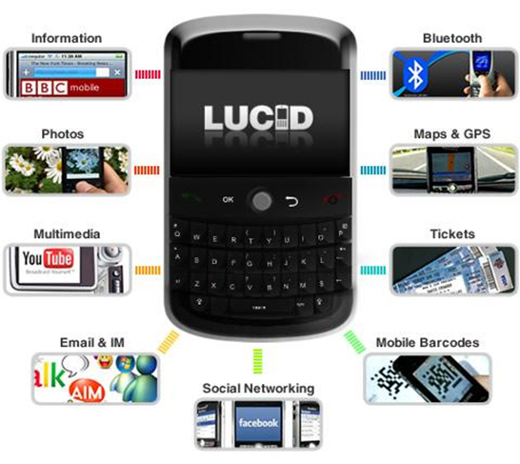
EC v. Samsung
Again, complaint to EU Commission filed by Apple
Samsung made commitments which provide guidance on legitimate conduct
– "safe harbour"
Key contents of Samsung's commitments
Framework before injunctions
Mandatory negotiation period
Do not force cross-licensing
If no agreement, determination of FRAND terms by court or arbitrator

Slide 7
Huawei v. ZTE
Referral by local court in Duesseldorf to ECJ
EU Commission decisions are not binding
In November 2014, Advocate General delivered his opinion on dispute
Court judgment accepted later in 2015

Slide 8
Huawei v. ZTE (2)
Advocate General proposes "middle path"
Alert licensee before seeking injunction
SEP holder must offer license based on FRAND principles – offer should specify all terms normally included in market practice, including amount of royalties and way of calculation
If patent holder and licensee cannot reach agreement, licensee needs to make reasonable counterproposal
Seeking injunction may be OK if licensee conduct is purely tactical and/or dilatory and/or not serious
Legitimate to request a bank guarantee or a deposit
Claiming damages for previous infringements is not abusive
But, licensee can challenge validity of patent after accepting licensing terms

Slide 9
For any questions, please contact:
Adrian Emch
Tel: +86 10 6582 9510
Email: adrian.emch@hoganlovells.com

Slide 10
www.hoganlovells.com
Hogan Lovells has offices in:
Alicante
Amsterdam
Baltimore
Beijing
Brussels
Budapest*
Caracas
Colorado Springs
Denver
Dubai
Dusseldorf
Frankfurt
Hamburg
Hanoi
Ho Chi Minh City
Hong Kong
Houston
Jakarta*
Jeddah*
Johannesburg
London
Los Angeles
Luxembourg
Madrid
Mexico City
Miami
Milan
Monterrey
Moscow
Munich
New York
Northern Virginia
Paris
Philadelphia
Rio de Janeiro
Riyadh*
Rome
San Francisco
São Paulo
Shanghai
Silicon Valley
Singapore
Tokyo
Ulaanbaatar
Warsaw
Washington DC
Zagreb*
"Hogan Lovells" or the "firm" is an international legal practice that includes Hogan Lovells International LLP, Hogan Lovells US LLP and their affiliated businesses.
The word "partner" is used to describe a partner or member of Hogan Lovells International LLP, Hogan Lovells US LLP or any of their affiliated entities or any employee or consultant with equivalent standing. Certain individuals, who are designated as partners, but who are not members of Hogan Lovells International LLP, do not hold qualifications equivalent to members.
For more information about Hogan Lovells, see www.hoganlovells.com.
Where case studies are included, results achieved do not guarantee similar outcomes for other clients. Attorney Advertising.
© Hogan Lovells 2015. All rights reserved.
*Associated offices

